Slide 1



高质量合成数据与应用供应商
AI-Based Synthetic Data/Application Vendor
ML5G-PS-009:
Synthetic Workload Data Generation using GANs
Beijing Quant Evolution Inc.（北京宽客进化科技有限公司）
China Mobile Research Institute（中国移动研究院）
2022.12.1

Slide 2

Problem statement
1
Cloud workload data, but limited availability.
memory_free
memory_used
cpu_user
cpu_system
cpu_idle
Shortterm
Midterm
Longterm
if_octets_rx
if_octets_tx
if_packets_rx
if_packets_tx
if_errors_rx
if_errors_tx
if_dropped_rx
if_dropped_tx
Memory
CPU
Load
Network
2
To solve this availability issue, train GAN model to generate synthetic observability data.
3
Simulate synthetic workload data in many scenarios

Slide 3
Solution overview
Data processing
Data generation
Assessment
Data facts
Data cleansing
Training WGAN-GP
Generate load, CPU, memory
Reorder the time series
Generate network
Evaluate synthetic data

Slide 4
Data processing
Data facts
Data cleansing
A. Non-uniform sampling time
Resampling data with 1 sec
Remove‘NAN’
B. Non-uniform features
Average the corresponding CPU, network data for each node;
C. Non-stationary time series
GAN models are individually trained for each node
D. ‘Load’ is the main factor
GAN models are conditioned by the tendency of the load.

Slide 5
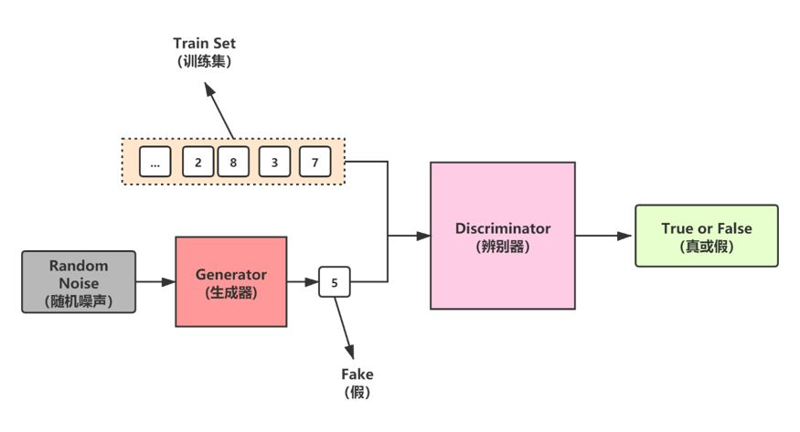
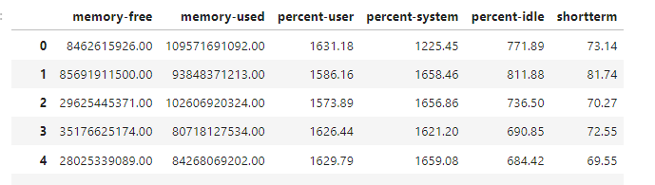
Data generation
Train GAN
Generated workload data

Slide 6

GAN Framework
WGAN-GP
Wasserstein GAN + Gradient Penalty, or WGAN-GP, is a generative adversarial network that uses the Wasserstein loss formulation plus a gradient norm penalty to achieve Lipschitz continuity.
Data processing

Slide 7
Train GAN models

Slide 8
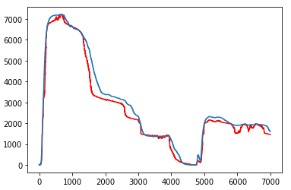
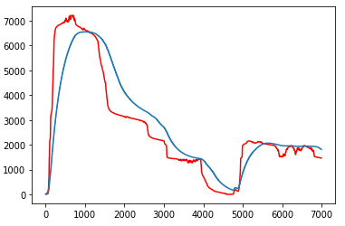
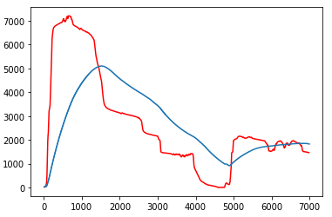
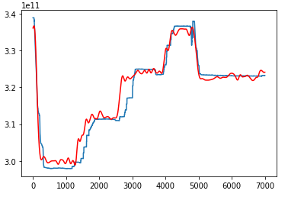
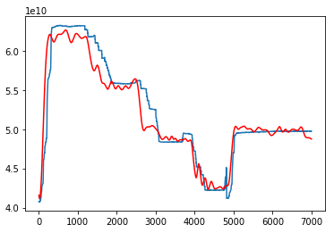
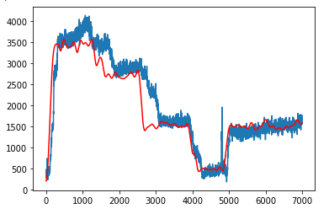
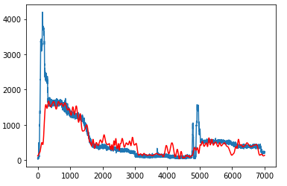
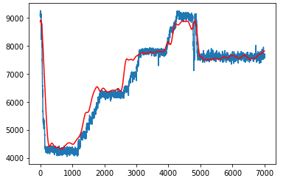
Real vs. Generated workload data
Shortterm
Midterm
Longterm
Memory free
Memory used
CPU user
CPU system
CPU idle

Slide 9
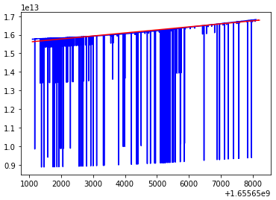
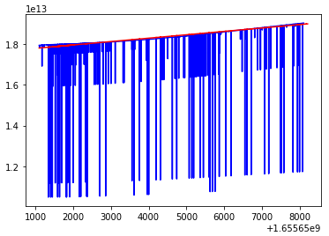
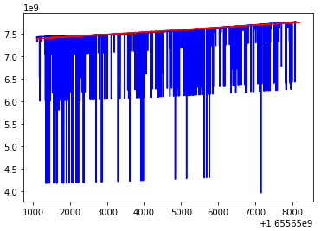
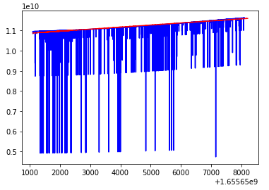
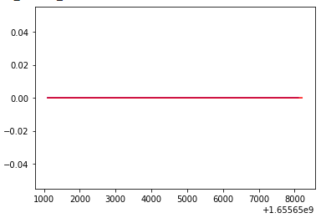
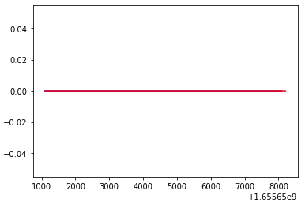
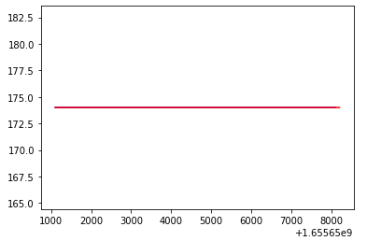
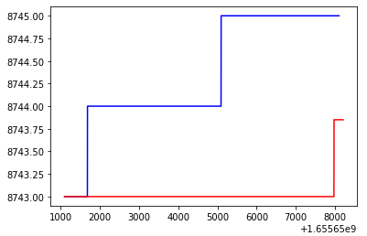
Real vs. Generated network data
If octets rx
If octets tx
If packets rx
If packets tx
If errors rx
If errors tx
If dropped tx
If dropped rx

Slide 10
Assessment: W-distance
W-distance | Memory free | Memory used | CPU user | CPU system | CPU idle | Shortterm | Midterm | Longterm
synthetic data | 0.0420 | 0.0489 | 0.0702 | 0.1847 | 0.0657 | 0.0540 | 0.1039 | 0.2483
real data | 0.0076 | 0.0123 | 0.0254 | 0.0208 | 0.0149 | 0.0140 | 0.0146 | 0.0271
random data | 0.2558 | 0.2510 | 0.1948 | 0.4511 | 0.2880 | 0.3421 | 0.3248 | 0.2273

Slide 11
Assessment: Autocorrelation
autocorrelation | Memory free | Memory used | CPU user | CPU system | CPU idle | Shortterm | Midterm | Longterm
synthetic data | 0.9509 | 0.9427 | 0.9462 | 0.9240 | 0.9571 | 0.9662 | 0.9661 | 0.9662
real data | 0.9541 | 0.9607 | 0.9221 | 0.8601 | 0.9498 | 0.9712 | 0.9811 | 0.9833

Slide 12
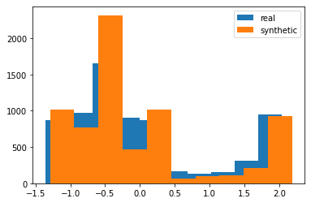
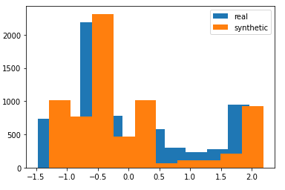
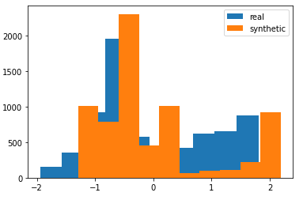
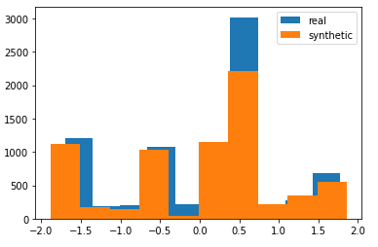
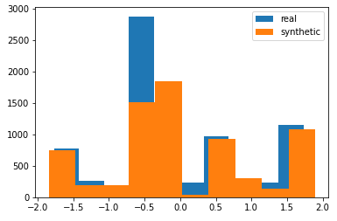
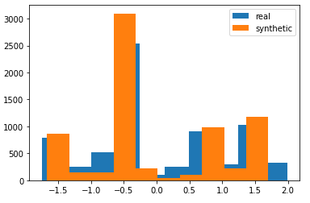
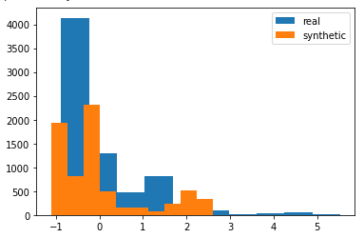
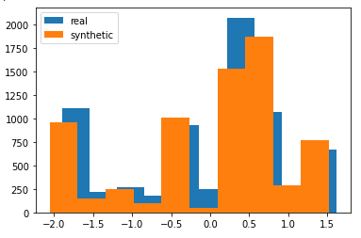
Assessment: Distribution
Shortterm
Midterm
Longterm
Memory free
Memory used
CPU user
CPU system
CPU idle

Slide 13
Generate workload data by conditions

Slide 14
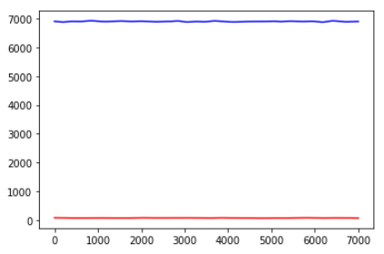
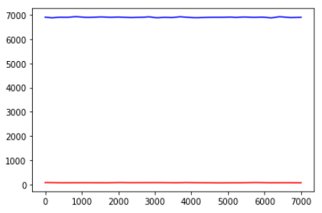
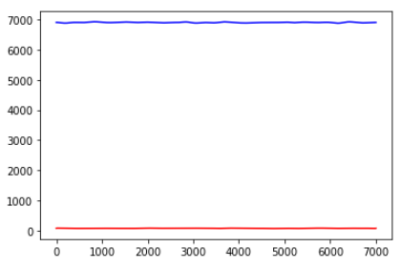
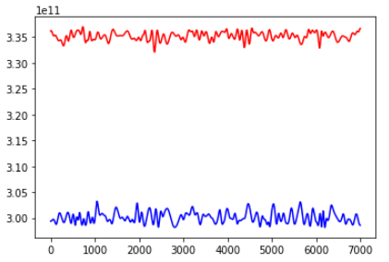
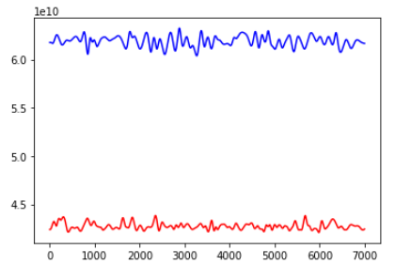
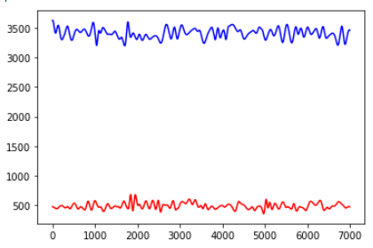
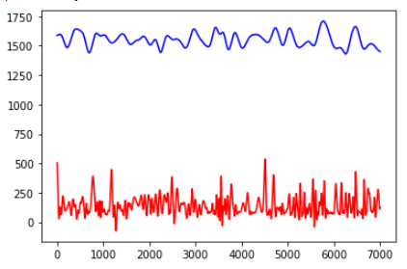
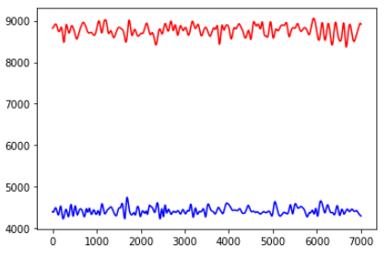
High/Low workload generation
High workload
Low workload
Shortterm
Midterm
Longterm
Memory free
Memory used
CPU user
CPU system
CPU idle

Slide 15
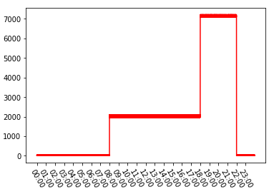
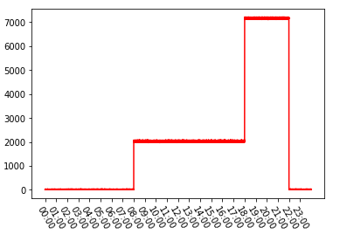
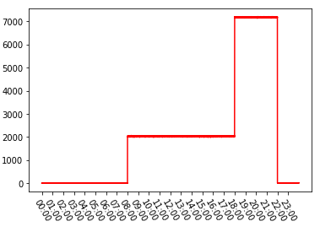
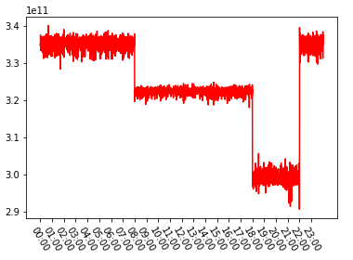
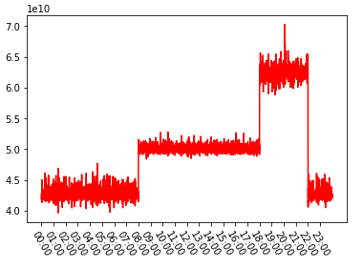
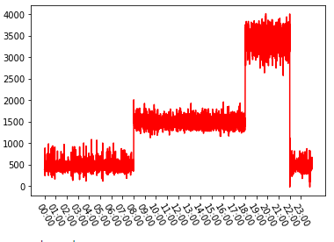
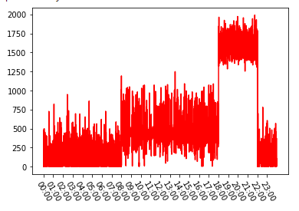
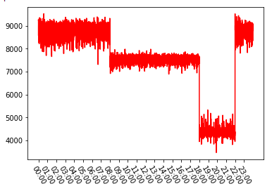
Daily workload generation
Daily workload
Shortterm
Midterm
Longterm
Memory free
Memory used
CPU user
CPU system
CPU idle

Slide 16
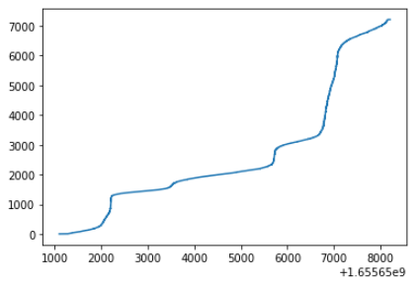
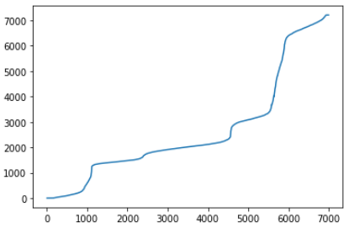
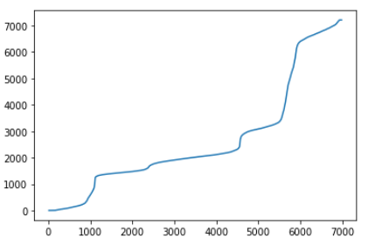
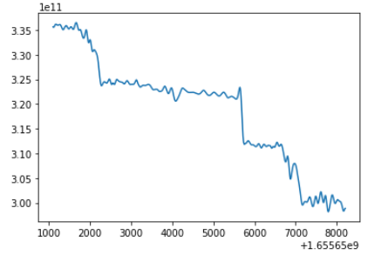
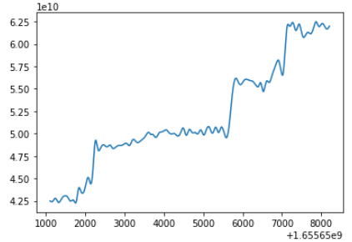
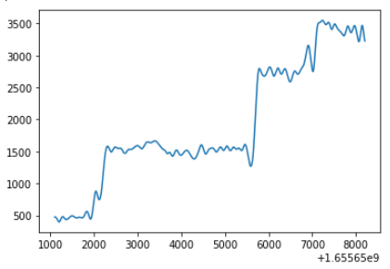
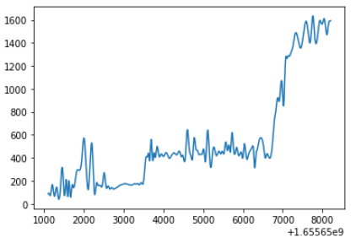
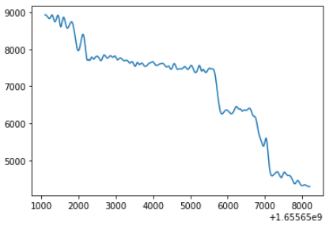
Complex workload generation
Workload climbs up
Shortterm
Midterm
Longterm
Memory free
Memory used
CPU user
CPU system
CPU idle

Slide 17
Conclusion
The feature correlations and time series information are treated separately.
The complicated feature correlations are generated from the well-trained GAN model.
After the generation, the time series information is rebuilt from the external conditions.
The generated workload data is highly reliable and in good performance.
GAN generated workload data is adaptive to many scenarios, which are unseen in the training dataset.

Slide 18

感谢指导
ai-quants.cn
deepgi.cn

